Slide 1
Telepractice Proves Effective for Those Living with Down Syndrome
Jennifer Gray, M.S., CCC-SLP
Maria Bernabe, M. S., CCC-SLP

Slide 2
Disclosure Statement Jennifer Gray, M.S., CCC-SLP
Self-employed at Grays Peak Speech Service, LLC
In private practice (children, teens, and adults) and Early Intervention specializing in Down syndrome speech, language, and feeding.
I have no financial relationship with the techniques and materials discussed in this presentation.
No royalties are acquired from materials or speaking events.

Slide 3
Disclosure Statement Maria Bernabe, M.S., CCC-SLP
Self employed by A Plus Speech Therapy, LLC
Private practice specializing in early intervention and telepractice
Blog: TelehealthSpecialists.com
No financial relationship with the techniques and materials discussed in this presentation
No royalties are acquired from materials or speaking events

Slide 4
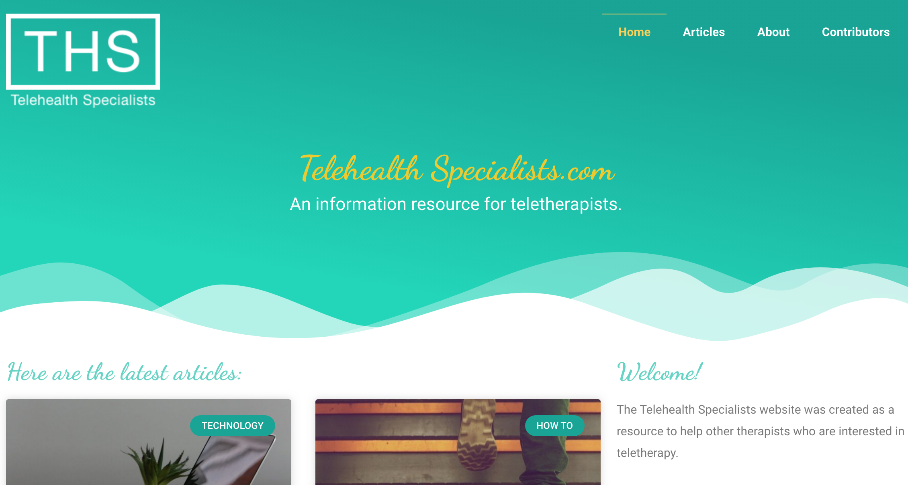
What is Telepractice
Remote service delivery using telecommunications technology where you and your client are in different physical locations. Therapy is provided using live audio and/or video but can also be pre-recorded (ASHA, 2019).
You must be licensed in the state where you reside and the state in which your client is located.

Slide 5
Service Locations
Early Intervention – home and community settings
Schools
Outpatient – Rehabilitation and Habilitative services
Private Practice
Anywhere with Internet service
Unconventional services
Volunteering
Collaboration with teams and specialists
Consults
Homework check-ins
Maintenance check-ins
Notes:
Talk about GiGi’s experience

Slide 6
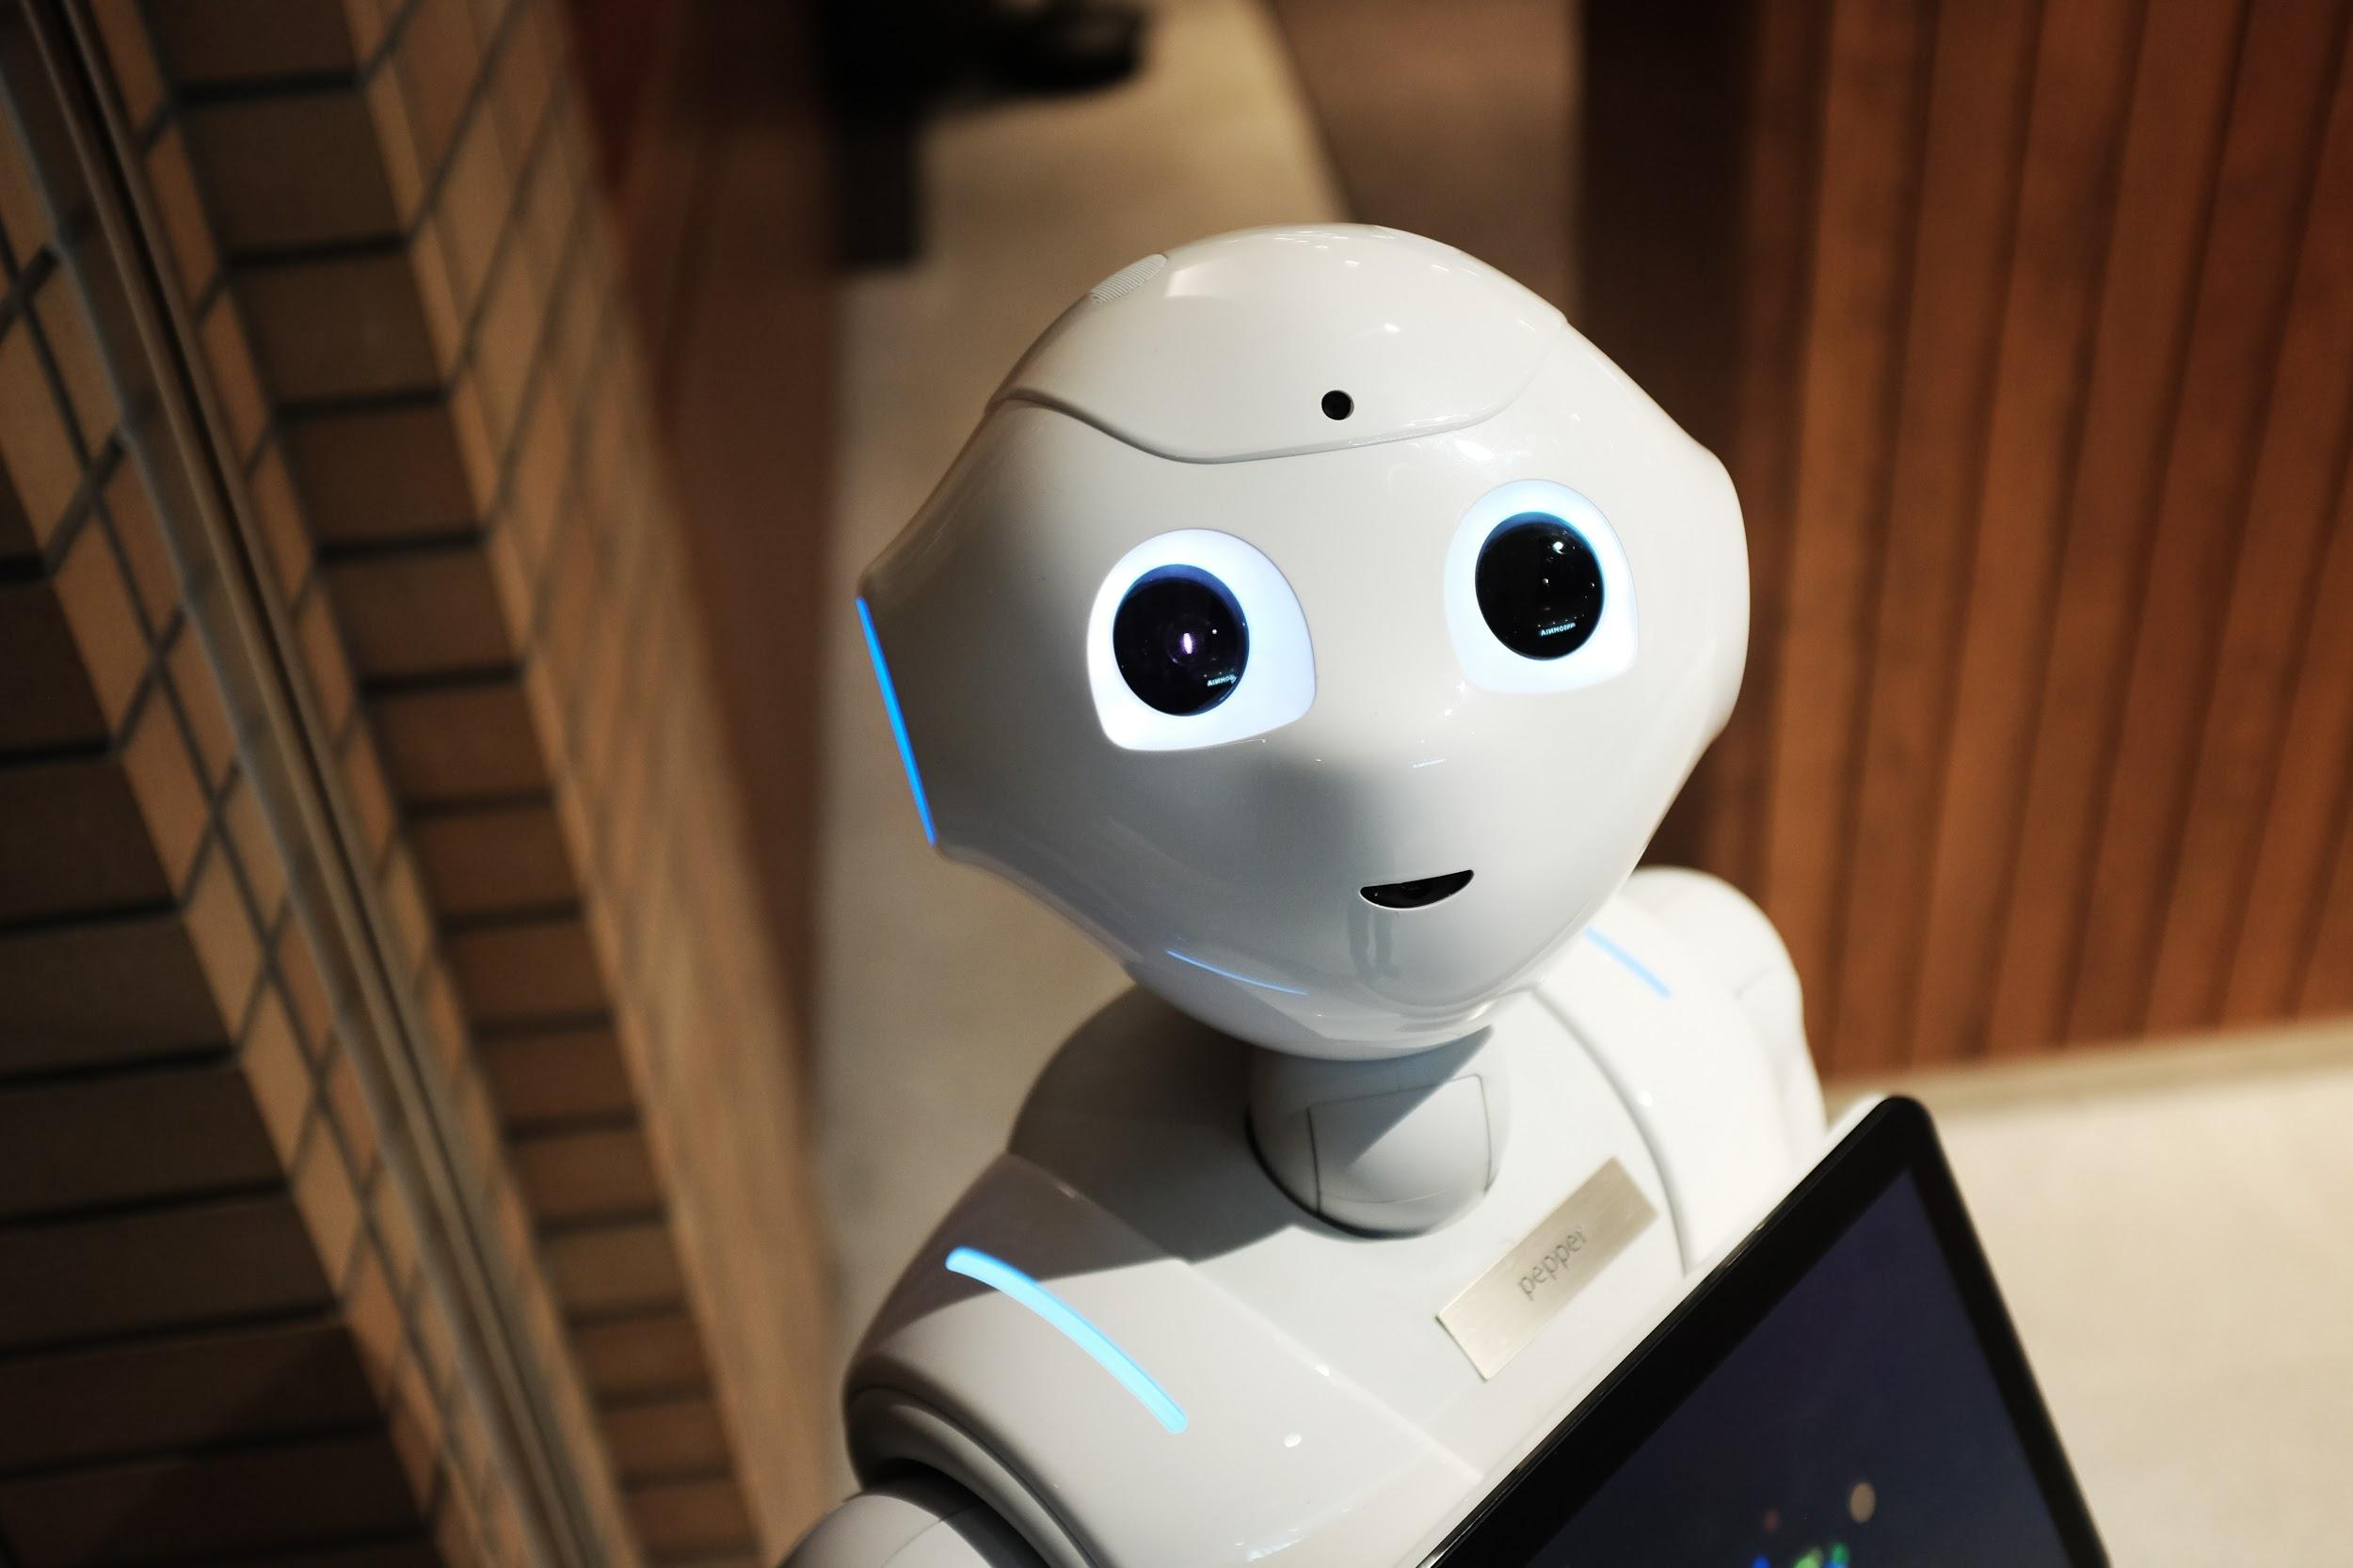
Technology Requirements
High Speed internet (bandwidth of > 20
Computer
Web camera
Audio
Software/hardware used for “virtual meeting space”
When selecting software there are several things to consider. Most importantly, consider security and be aware of potential threats that may put your client’s privacy at risk (Anne, Kelly, Houston, & Telepractice & eLearning Laboratory, 2013).

Slide 7
Privacy
What can you do?
Carefully select software that is secure - encrypted
Consider using a VPN to make internet connection more private (may slow down internet speed)
Ensure your client receives services only when authorized individuals are present
Have a plan in place to avoid and correct privacy issues
Use headphones so that others around you don’t hear what is being said
Store files and recordings in password protected devices
Require a password in order to enter an online session
Password protect PDFs if sending over email
Use a HIPAA compliant client portal

Slide 8
Platforms & Documentation
Online Platforms- software used to meet online with your client
popular platforms:
Zoom
Go To Meetings
WebEx
EverythingSLP.com - has a guide for helping you select a platform.
Documentation- creating and storing
several online options available such as:
G suite- cloud based system offering ability to create & store documents
Simple Practice - cloud based system for documentation & communication
Notes:
talk about:
what to look for when selecting platform
differences between g-suite (create docs, store information, powerpoint, excel, word) and simple practice (EHR, billing, secure transfer of data to clients.

Slide 9
Eligibility Requirements
One should consider physical ability, cognitive ability and vision and hearing ability. Cason & Cohn (2014) stated that “The client selection process should consider these limitations, potential modifications necessary to maximize participation, the nature of the interventions to be provided, and the support available to the client to determine if the use of telepractice is appropriate” (Cason & Cohn, 2014, p.12).
Consider the school, client and parents when asking yourself eligibility questions.

Slide 10
Eligibility Requirements cont.
Requirements for parents/caregivers:
space with minimal distractions
basic understanding of computer/technology needed
high speed internet
adequate equipment ability to set up/ troubleshoot with guidance
ability to complete carryover exercises online if assigned
ability to follow through with instructions, recommendations - requires time to build this skill
ability to set up activities/toys prior to the therapy session by following a plan sent ahead of time
available computer at the time of therapy session (scheduling)
if siblings present, are they productive participants or need babysitter?

Slide 11
Eligibility Requirements cont.
Requirements for client/student:
attend for at least 20-30 minutes with or without assistance
allow assistance from parent or e-helper (is behavior appropriate)
good vision (good enough?)
good hearing (good enough?)
can independently respond (use mouse, pointing, verbal, sign, gesture?)*
able to learn to use computer in order to effectively participate in sessions

Slide 12
EI Example Requirements/Eligibility in CO

Slide 13
Services Provided
Consults
Screenings
Consultations: Less frequent sessions or assessments only when billing is conflicting or when acting as a specialist consulting with an existing professional team
Evaluations, Dismissals
Treatment: weekly, bi-weekly, intensive
Intensive treatment: motor speech, CAS recommended frequencies (3-5x/week), LSVT, 5-minute artic
Groups
Functional and Social applications
Notes:
We can use telepractice to provide services in several locations as well as to provide serval services.
We can use telepractice not only for therapy but also for things like consultations, evaluations, and dismissals.

Slide 14
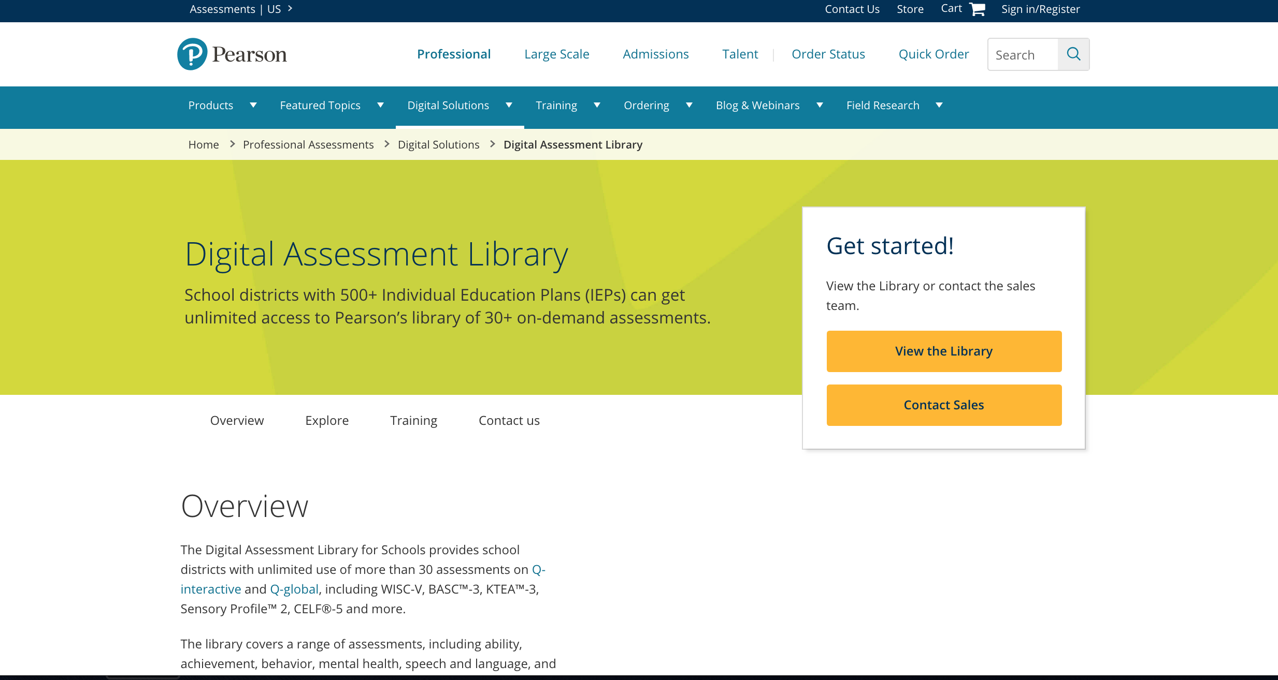
Online Test Administration
Available for Online Administration CELF - 5
GFTA -3
PPVT - 5
EVT - 3

Slide 15
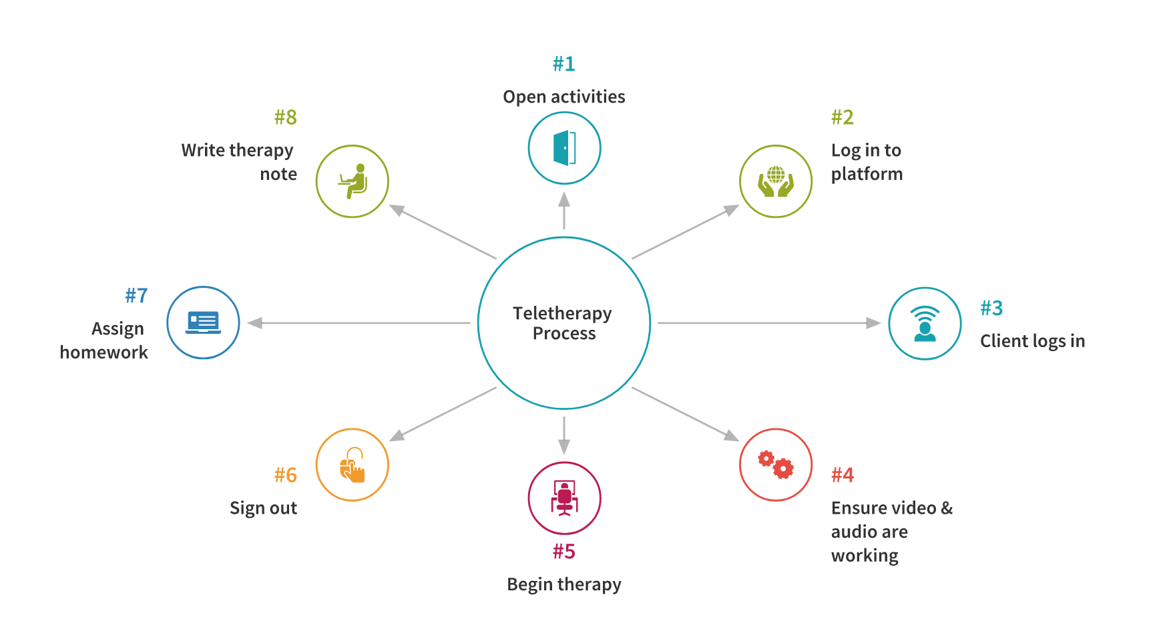
Example: therapy process for one session

Slide 16
Why is Teletherapy So Effective for Those Living with Down syndrome?
Most have specific learning strengths inherent to teletherapy.
Frequent (2+ days per week), intense, and brief sessions require higher level of planning, travel, and time in clinic settings and even in-home travel therapists can rarely accommodate.
Meaningful, contextual, and functional therapy activities are ESSENTIAL for success.
Sessions are:
visual
focused
consistent
Can be:
repetitive
intensive
frequent
short
Notes:
How I came to teletherapy before I knew about it’s formal use. I traveled all over the state, weather and distance made mountain towns difficult to access.

Slide 17
Treatments for Speech, Language and Feeding
Very few specialists and limited Down-syndrome-specific programs and techniques.
School and clinic therapies not enough:
very complex speech, language, learning, and health profiles
Those with DS need ongoing speech and language intervention throughout the lifespan (Buckley, 1993):
Birth to 3
Preschool
School age
Adolescent
Adult

Slide 18
Common Goals for those Living with Down syndrome
Speech clarity: articulation, phonology, motor planning, fluency, voice & resonance
Studies show all of these are usually present and should be treated accordingly
University of Vermont. (2016, February 5). More effective speech therapy approach for children with Down Syndrome. ScienceDaily. Retrieved November 20, 2019 from www.sciencedaily.com/releases/2016/02/160205100848.htm
Feeding: coaching and monitoring oral and pharyngeal phase eating, picky eating, messiness.
Receptive & expressive language, memory, auditory processing, cognitive learning and processing (Chapman & Hesketh, 2001).
Functional and social Language use. This is the #1 concern for parents of teens and young adults.
Daily living/Self-help, educational adaptations and performance, vocational preparation, and higher education.

Slide 19
Private & School Application:
Private HS student speaking at his own IEP while his therapist watches through Go To Meeting.
The student and therapist practiced
beginning with an outline, writing his own
index cards, and rehearsing each sentence
many times. He was allowed to keep his ideas
and use his humor (he is like this in real life
too).

Slide 20
Visual Teletherapy Tools
PowerPoint
Online Interactive: Boom Cards, SMART Exchange
TPT: Pre-made visual tools
Apps: Marco Polo
Video Modeling: Personal videos, Signing Time, Copy-Kids, Gemiini,etc.
Personal Books (make and print, Shutterfly, etc.)
You Tube
**Create your own library**

Slide 21
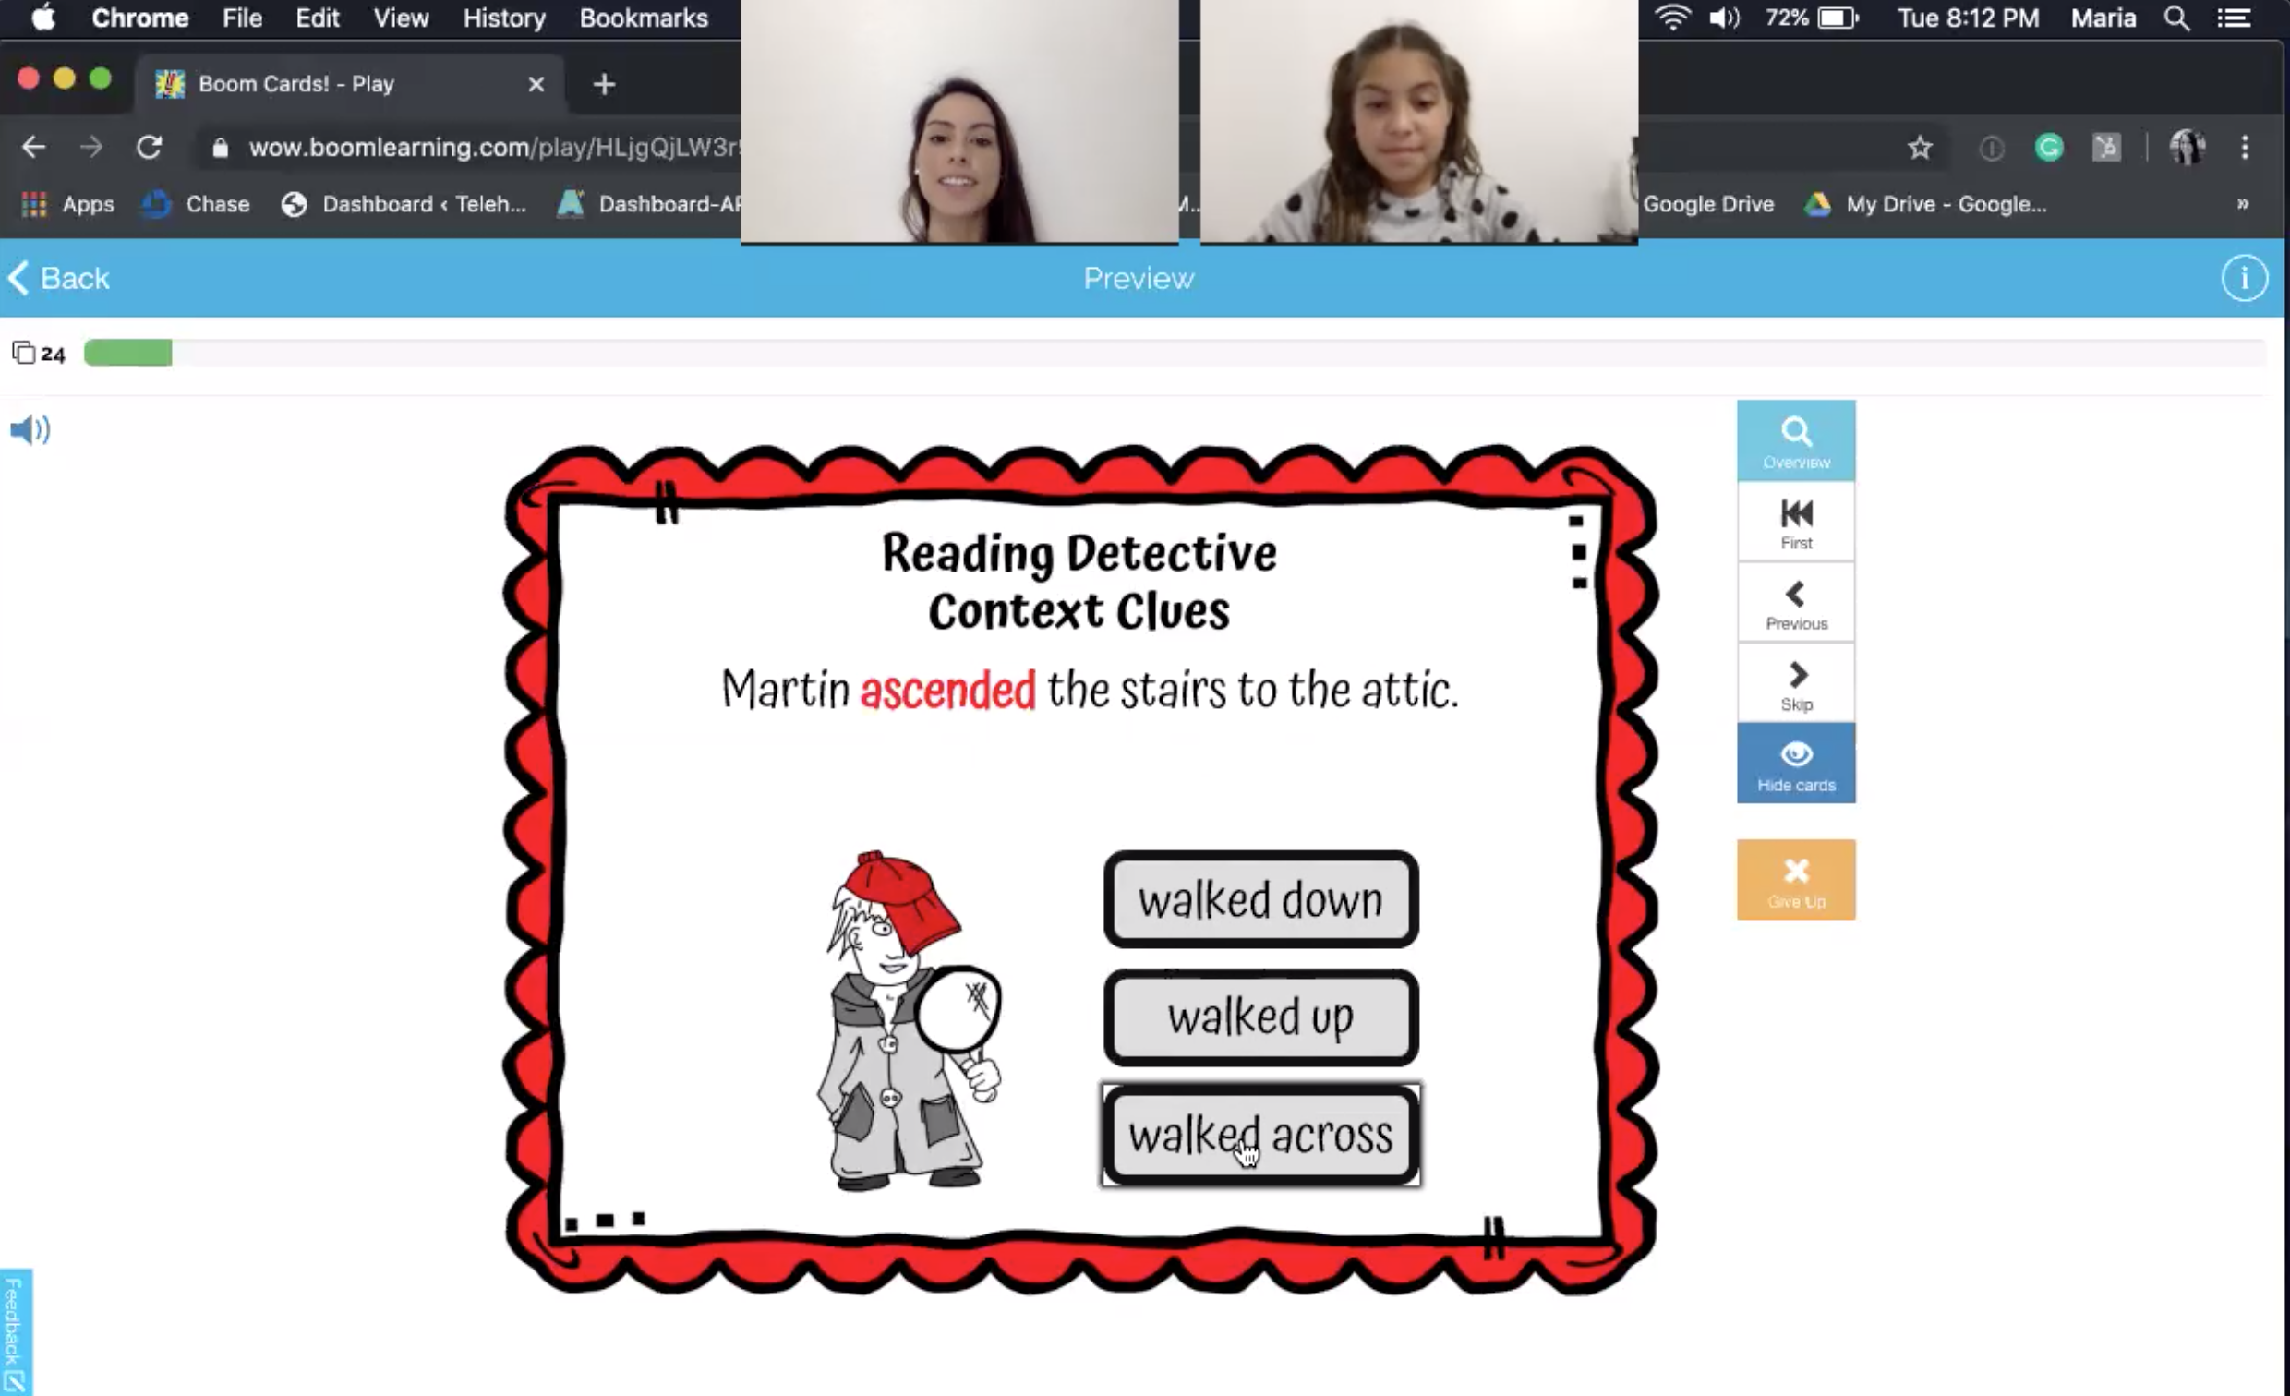
Screenshot Example of Boom Card Video

Slide 22
Example: Using Boom Cards During Therapy

Slide 23
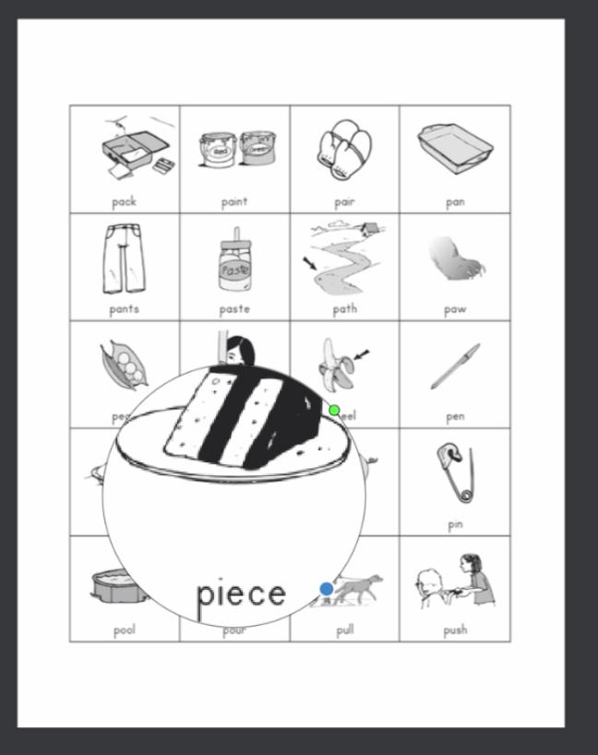
Screenshot Example of PDF Tools Video
Using a magnifying glass tool to play “detective” while practicing words beginning with /p/.

Slide 24
Example: Using a PDF worksheet during therapy

Slide 25
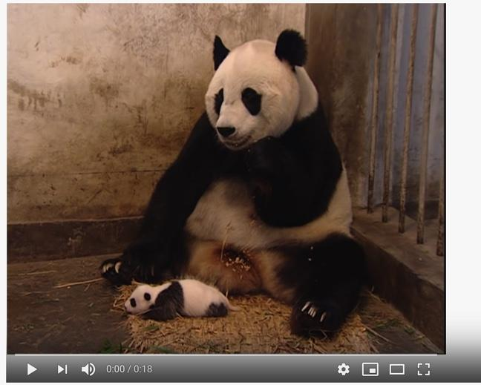
Use of video- For specific goals
Answering questions, retelling inferencing, sequencing, short-term memory, executive functioning, etc.
https://www.youtube.com/watch?v=93hq0YU3Gqk

Slide 26
Use of video- For specific goals

Slide 27
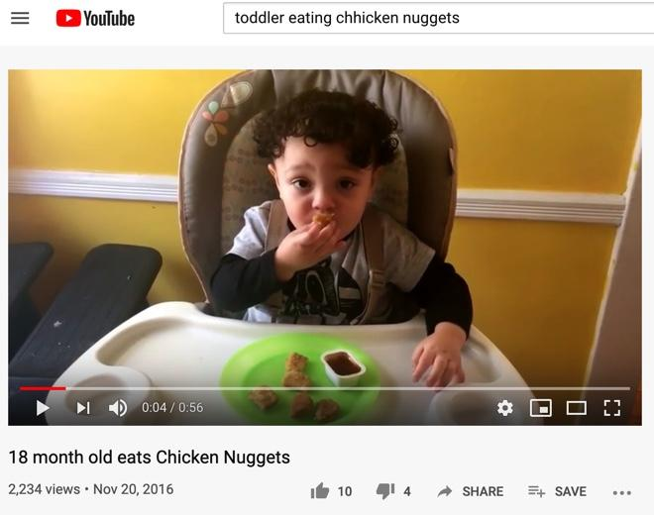
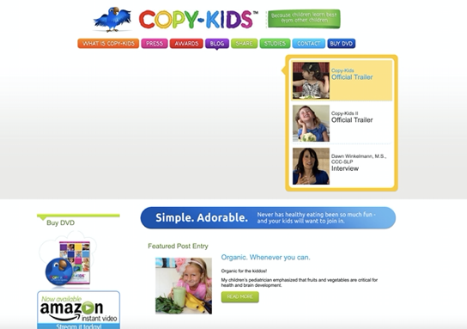
Video Modeling-Extremely effective for those who learn best visually.

Slide 28
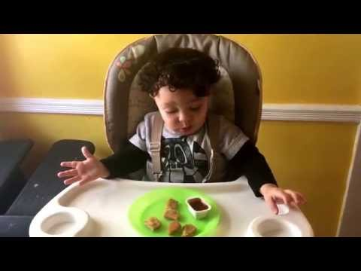
Video Modeling for Feeding

Slide 29
Power Point
-These can be made ahead of time or online-

Slide 30
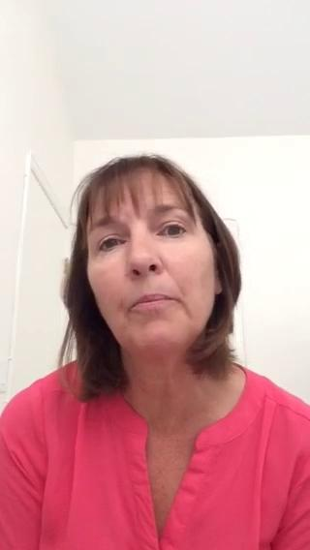
Mother’s Testimonial
Private client; 13 yrs old; LSVT & Speech and language interventions.

Slide 31
Teletherapy in Early Intervention
Some states have begun to offer telepractice/telehealth as an “equal” service.
Still used as a secondary modality
Better utilizes the coaching role and family education
Early studies reveal outcomes equal to in-person sessions in less time.
Fears of reduced child engagement
We have found it to be particularly useful for the DS population for the control of illness (especially those undergoing chemotherapy treatments or have compromised immune systems). Children with DS are sick more often than most other EI populations.
Ability to control stimuli. Overstimulation and refusal behaviors are very common .
Primary or One-Provider Models require therapists to monitor all aspects of a child’s development, health, and well-being.
Teletherapy allows a natural tendency to use the parent/caregiver for education and problem solving.
Supports the coaching model of intervention.

Slide 32
Early Intervention
Telehealth not only facilitates the therapists’ task of coaching families, recent studies have shown that coaching behaviors are actually enhanced in telehealth sessions because the provider is not physically present in the home.
Behl et al. 2017

Slide 33
EI Findings
Telepractice is an effective way to teach families language facilitation strategies in naturalistic settings.
McDuffie and colleagues reported that the use of telepractice was effective in teaching mothers of children with Autism how to use specific strategies for responding to their child’s communication acts.
Mothers were taught to use commenting, interpret communication acts, expand communication attempts and provide indirect prompting.
They found no significant difference between on-site and telepractice coaching and education.
McDuffie et al. 2013
Another study conducted with mothers of children with Fragile X syndrome found that telepractice was an effective when using a coaching model for teaching how to respond to communication acts.
Lessons were provided to teach mothers how to use indirect and direct prompts as well as how to respond to communication acts.
Mothers were able to increase their ability to use verbally responsive language.
McDuffie et al. 2016

Slide 34
Myths
The online training offered to Colorado practitioners contains a section on dispelling myths about telehealth.
One myth is that telehealth is “lesser than” in-person services. Research is demonstrating that this is not true, and that in actuality, children’s outcomes are sometimes even better than those for children who are receiving services by an in-person therapist (Blaiser & Behl, 2015; Baharav & Reiser, 2010).
Another myth is that providers aren’t able to build rapport with families when telehealth is used. When one looks at the relationships developed over social media, this myth can be dispelled.
Finally, there is a myth that technology is very expensive and difficult to use. There are so many different platforms that meet the needs of providers who are utilizing telehealth that finding one that meets a therapist’s and family’s needs is increasingly easier and less expensive.
International Journal of Telerehabilitation: Development of Statewide Policies & Procedures

Slide 35
Video & Pic Example(s)
Myth: Young children can’t attend to a screen long enough for a productive session. Playing with a person in the same room is the only way she will engage.
Child A.T. began speech, lang, and feeding services in EI and remained with same therapist for private services when she turned 3 years-old.
She has Down syndrome and was/is going through chemotherapy for leukemia. This makes her susceptible to common germs and infections that could jeopardize her health.
Her dad is with her every session. She began in a high chair and is now content with dad’s lap.

Slide 36
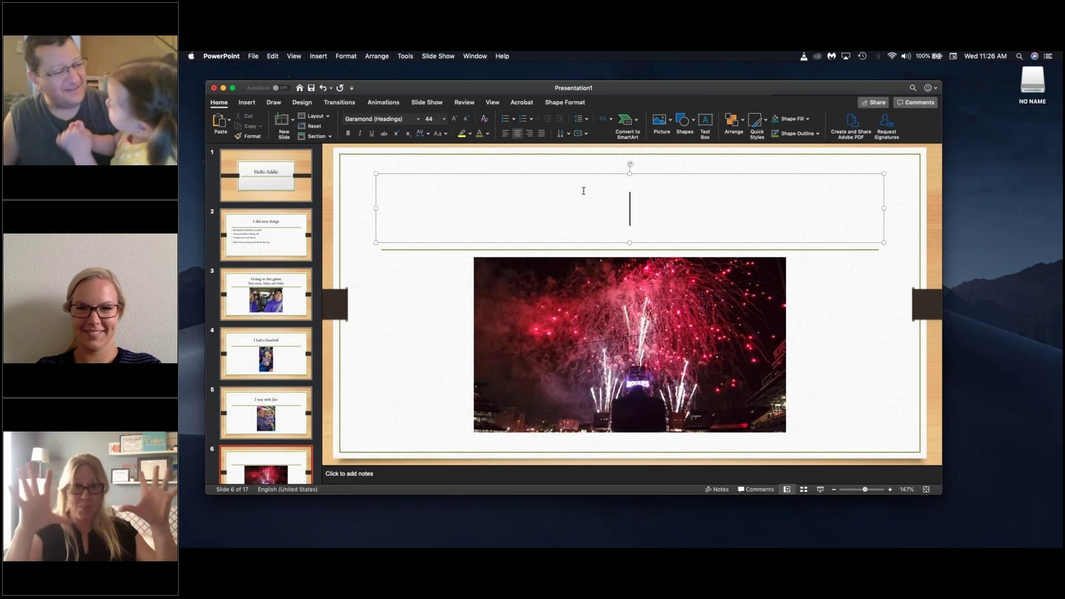
EI example with multiple viewers
AT is 2.9 years-old

Slide 37
Groups and Social/Functional Purposes
Functional skills: conversation, friendships, mutual interests, shared experiences, similar strengths and needs
Can be mixed DS and non-DS - this may be better as children become teens/adults Peer Models (not just Paras).
Use of additional technologies: social media, Apps
Themes: Cooking, biking, chores, movies, music, etc
Use of weekly Teletherapy with weekly or monthly groups in the community or using social communication apps (e.g., Marco Polo).

Slide 38
Independence!
Creates opportunities to begin and end own sessions.
Creates opportunities to schedule their next appointment.
Enables communication with friends, peers, relatives, teachers, etc. using:
Visual and written technology
text, email, video, media
Visual recorded homework and check-ins

Slide 39
PowerPoint Example

Slide 40
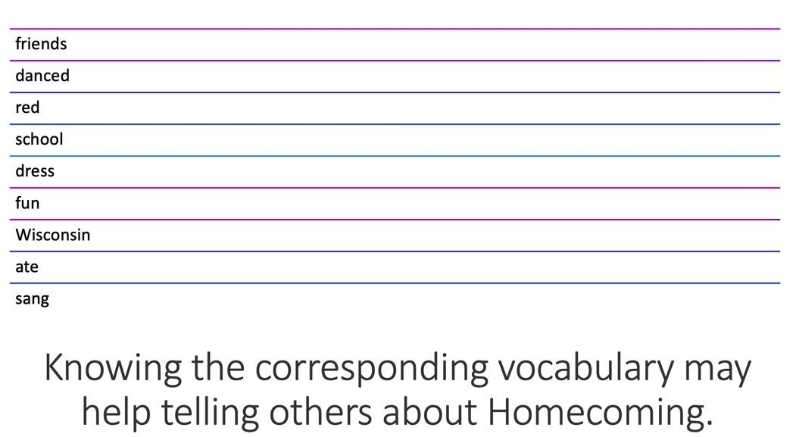
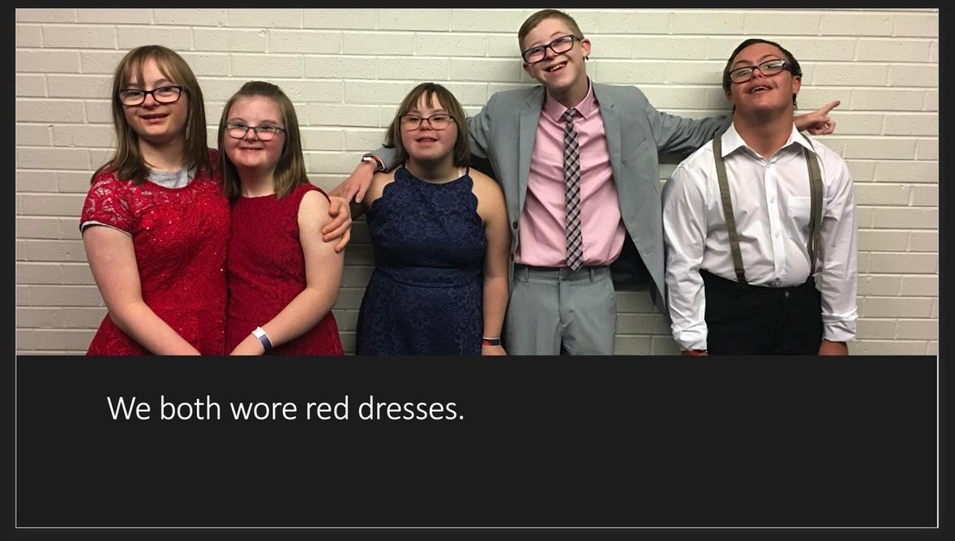
Make Topics Personally Relevant

Slide 41
Resources
Free Books on PDF https://freekidsbooks.org/
Free Songs with Lyrics and Videos https://supersimple.com/
Free & Paid Activities https://wow.boomlearning.com/
Free & Paid Online Games https://chrome.google.com/webstore/
Free Downloadable Activities: http://SpeakingofSpeech.com
Online Activities https://exchange.smarttech.com/

Slide 42
Resources
Power Point
www.pinterest.com
https://tactustherapy.com/
Many, many Apps
Research and resources for medical concerns and comorbid disorders: aphasia, apraxia/childhood apraxia of speech, auditory processing disorders, autism spectrum disorders, AAC use, chronically ill, dysarthria, feeding, fluency, intellectual disabilities, short-term memory/executive functioning, reading/literacy acquisition and use, sensorimotor disorders, etc.

Slide 43
Reference List
Anne, M. F., Kelly, J. B., Houston, K. T., & Telepractice & eLearning Laboratory. (2013, April 1). Putting the "Tele-" in Telepractice. doi/full/10.1044/tele3.1.9.
Behl, Diane D. MEd; Blaiser, Kristina PhD; Cook, Gina PhD; Barrett, Tyson BS; Callow-Heusser, Catherine PhD; Brooks, Betsy Moog MS; Dawson, Pamela MEd; Quigley, Suzanne PhD; White, Karl R. PhD.A Multisite Study Evaluating the Benefits of Early Intervention via Telepractice. Infants & Young Children: April/June 2017 - Volume 30 - Issue 2 - p 147–161
Buckley, S. (1993). Developing the speech and language skills of teenagers with Down's syndrome. Down's Syndrome: Research and Practice, 1, 63-71. [Read Online ]
Cason, J., & Cohn, E. R. (2014). Telepractice: An Overview and Best Practices. Perspectives on Augmentative and Alternative Communication,23(1), 4. doi:10.1044/aac23.1.4.
Chapman, R, and Hesketh, L. (2001) Language, cognition, and short-term memory in individuals with Down syndrome. Down Syndrome Research and Practice, 7(1), 1-7. doi:10.3104/reviews.108

Slide 44
References Cont.
Wishart, J. (2001) Motivation and learning styles in young children with Down syndrome. Down Syndrome Research and Practice, 7(2), 47-51. doi:10.3104/reports.113
McDuffie, A., Machalicek, W., Oakes, A., Haebig, E., Ellis Weismer, S., & Abbeduto, L. (2013). Distance video-teleconferencing in early intervention: Pilot study of a naturalistic parent- implemented language intervention. Topics in Early Childhood Special Education, 33, 172–185.
Mcduffie, A., Oakes, A., Machalicek, W., Ma, M., Bullard, L., Nelson, S., & Abbeduto, L. (2016). Early Language Intervention Using Distance Video-Teleconferencing: A Pilot Study of Young Boys With Fragile X Syndrome and Their Mothers. American Journal of Speech-Language Pathology, 25(1), 46–66. doi: 10.1044/2015_ajslp-14-0137
Vani Rupela, Shelley L. Velleman, Mary V. Andrianopoulos. Motor speech skills in children with Down syndrome: A descriptive study. International Journal of Speech-Language Pathology, 2016; 1 DOI: 10.3109/17549507.2015.1112836
https://gallery.mailchimp.com/77bac9f533d6bce265cae77d9/files/20161215Published_Article_1_.pdf

Slide 45
Contact Us
Jennifer Gray, M.S., CCC-SLP
Maria Bernabe, M.S., CCC-SLP
Email: jennifer@grayspeaktherapy.com
Website:
www.grayspeaktherapy.com
Email:
maria@aplusspeech.com
Websites: www.aplusspeechtherapy.com
www.telehealthspecialists.com

