Slide 1
Effective Strategies for Communication and Learning (birth-5 years)
Jennifer Gray, M.S., CCC-SLP
Grays Peak Speech Services, LLC
Jennifer@grayspeaktherapy.com

Slide 2
Disclosure Statement
Grays Peak Speech Service, LLC
Private practice (children, teens, and adults), Early Intervention, and early education providing speech, language, and feeding services.
I have no financial relationship with the techniques and materials discussed in this presentation.
No royalties are acquired from books, materials, or speaking events.

Slide 3
What is Communication?
Communication is any attempt to convey information or news.
OR
A means of connection between people or places, in particular.
Our children tend to be good communicators.
However, they may not be very effective at communicating appropriately.

Slide 4
Appropriate communication
Speech production, speech clarity, expressive and receptive language.
Receptive language skills tends to be much higher than expressive language skills and speech clarity is reduced.
Many parents and therapists are good at teaching receptive language (what the child learns and knows) and less sure about how to improve expressive language skills (what a child can tell us) and speech clarity (how well they are understood).

Slide 5
Needs to be Meaningful
Everyone learns better when interested in the learning content.
Avoid tasks divorced from previous experience, knowledge, interests (worksheets not personalized). Sometimes necessary (math concepts), but can add visual supports.
Abstract concepts are difficult and even harder with out meaning (time, money).
Use strengths to bridge learning.
Many exposures prior to trying.
Teach the task first.
Expect ability/capability

Slide 6
Meaning and Concrete Thinking Example 1
When receptive language (what is understood) is better than expressive (what s/he can say) abilities children will go to great lengths to let us know they understand what we are talking about.
For example: when talking about colors s/he may leave the situation and go get something the color mentioned.
This may seem untimely: talking about how to sign orange causes the child to attempt to tell or show you something. If that doesn’t work they may try again then leave the room. We may think s/he is avoiding or not paying attention. But the child returns with a car that’s orange, hands it to you, and signs/says “orange”.
This has happened to me many times. Now I sit and wait for him/her to return.

Slide 7
Meaning Example 2
Teaching the vocabulary first or reviewing pictures from and event or book first will allow the child to have a better grasp of the context and a change to listen to the words used.
If you want your son/daughter to tell grandpa about the baseball game over the weekend it will be smoother if you show some pictures first, using the vocab you expect him/her to use.
“Here we are in line to get in. _____is wearing his/her baseball hat and holding his/her glove.”
“Here is a picture of____ eating a hot dog with too much ketchup.”

Slide 8
Meaning
The above examples provide a review for everyone and subtleley reminds the child about the words used. When talking is difficult, but the movie of the event in their head is strong, a child may guess what words to use when quizzed or may even freeze, flee, or act out despite knowing the answers.
This eliminates guessing and allows the child a better chance at retelling an event to someone who was not there.

Slide 9
Requesting
One of the first engagements we use
Builds conversational partners

Slide 10
Build opportunities to request into as many activities as can to engage your child: eating, dressing, play, etc.
Ask your child to make choices beginning in fields of two. Starting with pointing then by naming (sign or speech).
Use visual choices as much as possible and be ready to give it to the child immediately.
The child will learn they have to use purposeful communication to get what they want. When this reciprocity is expected the child will be more likely to use appropriate communication to get wants and needs met.
We are very good at anticipating what our children want and need. For speech to best emerge I teach parents to pretend to not know and give choices.
The annoying sound s/he makes when displeased or the one that tells you that you guessed what they want incorrectly should indicate a chance to give a choice or ask for a sign or word.
Try to not let smiling, hugging, crying, grunting be used as effective communication.

Slide 11
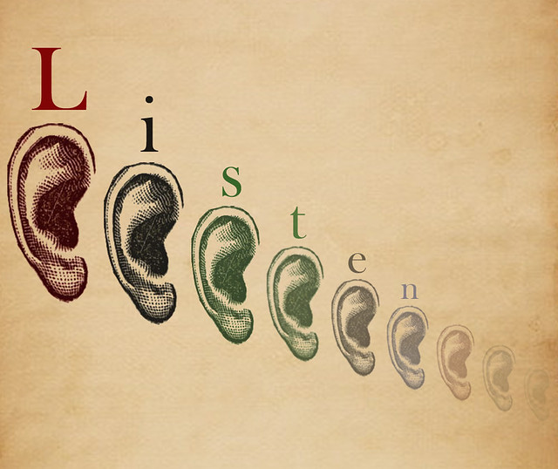
Early Receptive Approaches
Talk a lot!
about what you see/do/feel.
https://youtu.be/XomEA2ChjeE
Bombard him/her with language/vocab you want him/her to learn and use.
Enrich the environment with communication opportunities (objects out of reach, different environments, exposure to peers, structured environments, and new experiences etc.).
Follow the child’s lead (for language learning).
“Test” knowledge with questions and instructions (e.g., which one is the dog, find the ball) using objects, flashcards, and tasks/chores.

Slide 12
Receptive Language Strategies
Music and singing (attains and retains attention).
Giving choices (clothes, food, toys, actions).
Flash card work.
Book reading
Pointing and naming the item on the picture when asked “wh” questions.
Ask Where/Which questions first (Where is the dog/Which one is the ball?).
Then ask What (what is that/this?).
Passive language strategies: Signing Time, Gemiini, Copy-Kids, YouTube, video modeling, personal books, etc.
This Photo by Unknown Author is licensed under CC BY-SA

Slide 13
Sequencing and categorizing.
Following multiple direction
Where is your nose, what does a doggie say, point to your eyes and then your leg, give me the ball and then the car, etc.?
Where do the forks go?
Games like “red light green light, Simon says, tablet apps (Video Touch),
Counting bears
Retelling
Apps like endless reader, I Can Do apps
Short-term memory/Ex Function skills should be targeted early
Chores: laundry, cleaning up, setting the table, bath-time routines, doing dishes, etc.

Slide 14
Picture and Literacy Approaches
Lay 3-10 pictures on the table or floor and ask your child to find a specific card or item (visual interference). They will pick up the card or item they see first or like best initially.
Then ask them to find a picture or item and hand it to you (two step directions).
Matching (pic to pic, object to object, object to pic, pic to word, word to word)
Fast flashing with picture cards with words on the back. Greater visual skills make this task easier than expected.
See and Learn program.

Slide 15
Early Expressive language
Imitation of facial movements (expressions, lip and mouth movements, hand movements, etc.)
Hand gestures
Sign Language – the first step to meaningful communication. Always paired with speech.
AAC – non-speech generating
Singing and music (itsy bitsy spider, twinkle twinkle little star, etc.). App called “Sign and Sing.”
Prompts for Restructuring Oral Musculature Phonetic Targets (PROMPT)

Slide 16
Anatomy of Oral Structures
Smaller skeletal system and more typical soft tissue structures (i.e., tongue).
High and narrow palate: resonance differences (hyper and hypo).
Limited room for the tongue posterior to dentition.
Narrow and windy ear canals.

Slide 17
Physiology
Dysarthria and Hypotonia of all muscles of the body including those for speech: tongue, lips, facial muscles, pharynx, larynx.
Loose or lax ligaments: the jaw is a joint/ligaments
Due to physiological differences, sounds and words will be impacted by imprecise or exaggerated oral movements.
Low tone and dysarthria cause the tongue, lips, and cheeks to feel and look relatively larger than other oral structures; affects precision, agility, and coordination for speech.
Affects pulmonary function and control for all movement including speech and feeding.
Mouth breathing
Sleep apnea
Hearing loss

Slide 18
Physiology of Entire Body Affects Communication and Learning
Gross motor control and abilities precede fine motor skills and dictate when eating, drinking, and speech develop.
When the typical developmental hierarchy is modified or neglected, other developmental skills suffer: eating, speech and language, and learning.
Health and medical conditions also dictate every area of development and successful acquisition of abilities
Language skills like syntax and utterance length may be affected more by a child’s physiology than his ability to learn and remember language rules (initially).
Spontaneous speech is often clearer than interactive speech, but difficult to reproduce.

Slide 19
Oral-motor/Oral Placement Therapies
Beneficial prior to eating and speaking.
An effective tool to help our children achieve appropriate oral movements for speech and feeding.
Teach our children how to use controlled oral movements for speech.
Teaches them how to move the jaw, lips, and tongue independently and simultaneously.
Horns, bubbles, chewy tubes, bite blocks, straws, etc.

Slide 20
Sensory Concerns Low tone can also translate into not feeling movement or objects in the mouth appropriately.
Each of these can become problematic if they don’t subside
Teething
Drooling
Tongue thrusting
Food stuffing
Mouth breathing
Teeth grinding
Nasal snorting
Tongue sucking

Slide 21
Feeding Issues include:
Feeding Issues Include:
Reduced tongue lateralization
Tongue thrusting
Inadequate or inconsistent lip closure
Mouth breathing
Food stuffing
Picky eating, food jagging, stuffing, gagging, choking, spitting out, poor chewing, pocketing, skipping classes of foods, regression

Slide 22
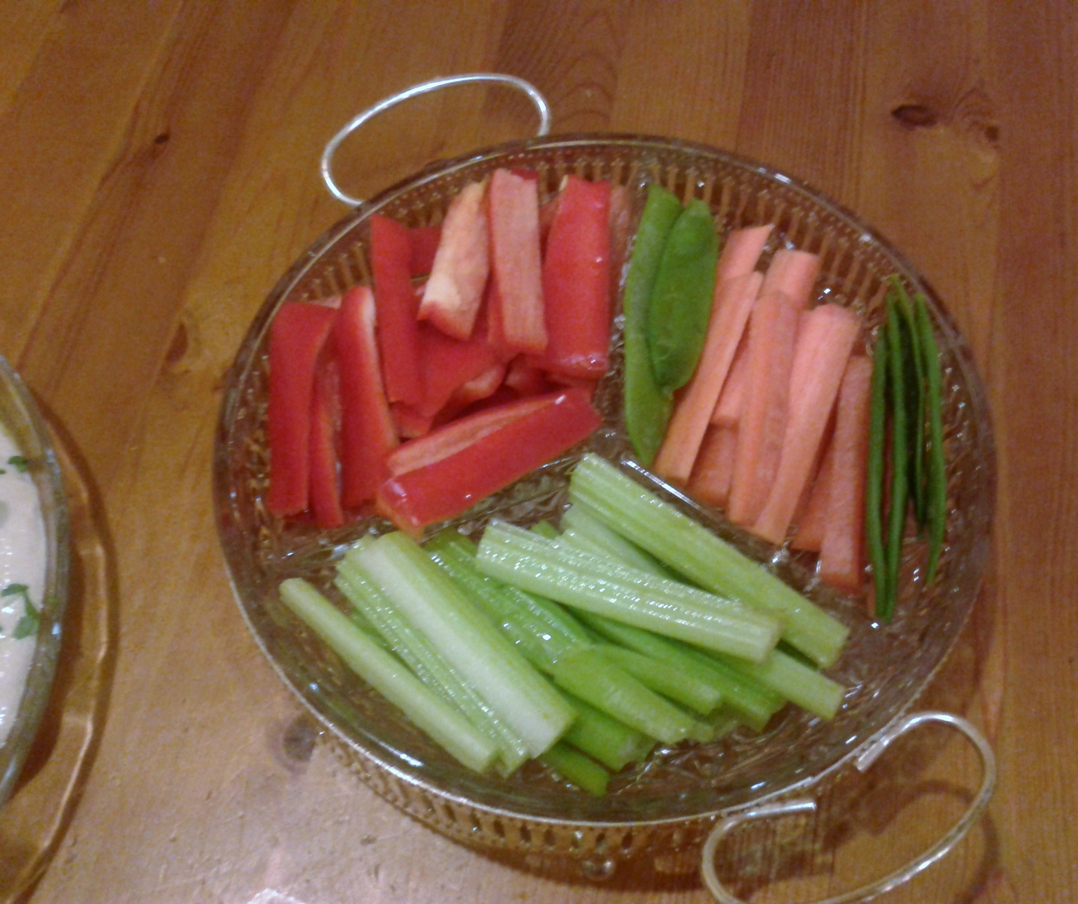
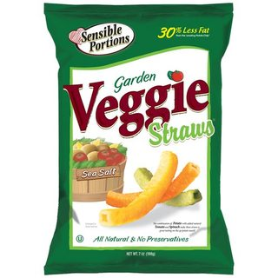
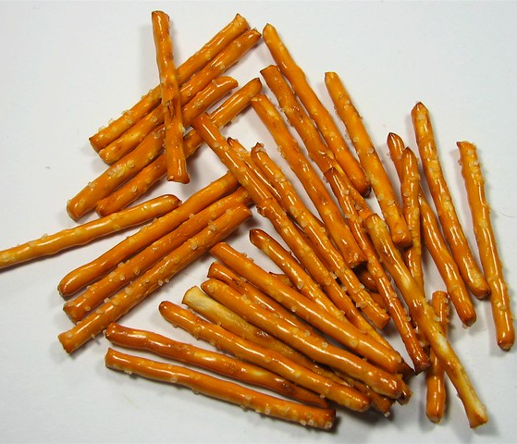
Feeding Strategies
Straw drinking: honey bear to straw hierarchies
Sippy cups and open cups
Stick foods
Spoon and fork use
Foods that are developmentally appropriate
That match gross and fine motor abilities; not age.
Foods that promote desired movements of the jaw, lips, tongue (sometimes cheeks).
2 plate method
Family style meals
This Photo by Unknown Author is licensed under CC BY-SA
This Photo by Unknown Author is licensed under CC BY

Slide 23
Chewing
Essential for feeding safety and speech production
Non-food items first (chewy tubes, etc.) if needed.
Meltable solids
Placement of thick purees, mixed textures, and soft solids encourage tongue lateralization.
Melanie Potock’s resources
Diane Bahr’s books

Slide 24
How does feeding relate to speech?
Feeding strategies that promote controlled oral movements act as a bridge to achieving those movements in speech.
1
Those movements are: vertical jaw depression and elevation, tongue lateralization, lip closure and rounding.
2
If movements for feeding are impaired those same movements will be impaired during speech production.
3
Feeding provides ample time to work on speech and language skills since eating is a social time.
4
Requesting, turn taking, imitation can easily be built into these activities.
5
Child is seated for optimal success when practicing speech movements as well as feeding.
6

Slide 25
Speech
Speech and speech clarity are often the primary concern for families I see.
Speech and language are the most intricate and complex actions we do each day.
There are many movements and neurological steps when speaking.
Poor clarity persists into adulthood and continues to fluctuate despite improvement in cognition, reactions of others, previous successful therapies, or previous use of strategies.
A system that must be maintained apart from language skills. Language skills can improve without speech skills improving.
Poor speech intelligibility often leads to shorter and simpler utterances in an attempt to be better understood (telegraphic speech).
For the most part, people living with Down syndrome continue to speak despite poor success.

Slide 26
Speech accuracy
Verbal communication attempts should be expected from birth.
Tongue retraction is crucial.
Speech and alternative communication (sign language, picture exchange, devices) should be paired.
2+ word phrases may include speech and all other modalities.
Articulation, phonological errors, and motor planning are to be expected and corrected as appropriate for age.
High frequency and intensity models work best.

Slide 27
Speech Clarity Ebbs and Flows

Slide 28
Why is clearer speech so hard to achieve?
Anatomy and physiology
Low tone causes slower response to desired movement and uncontrolled agility (rapid or slower than typical movement patterns)
Speech requires sophisticated combination of rapid movement
Easiest in single words
Less clear when additional factors must be managed (co-articulation, starting and stopping movement, new incoming information, time pressure, desire to be heard or understood, etc.)
Research suggests articulation, phonological processes, and motor planning are all potentially delayed or impaired.
***Implications for treatment***

Slide 29
Use Strengths to Overcome Weaknesses
Strengths
Weaknesses (relative)
Social and emotional
Spatial skills
Visual learning
Long-term memory
Music
Can focus if interested
Proud confidence in themselves
Auditory learning
Short-term memory
Rhythm
Meta skills and rigidity
Internal motivation to improve
Poor turn-taking and reciprocal skills.
Empathy and affect

Slide 30
Perceptual Characteristics of Speech
Hearing Loss
Changes occur over time and are inconsistent
Resonance: Consistent hypernasality/hyponasality.
Breathy voice quality and vocal fry
Monotone; little to no stressed syllables
Uncontrolled rate, rhythm (prosody), and pitch (fundamental frequency, optimal pitch), and loudness.
Imprecise articulation.
Slushy or lisping phonemes
Fluctuating fluency and stuttering
Notes:
H
Just list
No explanations

Slide 31
Speech Clarity is Complex
Segmental
Articulation: sound production
Phonology: systems and patterns of sounds to convey meaning
Motor Planning: imprecise timing of coordinated movements
Suprasegmental (quality)
Prosody: Intonation, rhythm, rate
Voice: pitch and loudness
Sustaining phonation
Syllable and word Stress
Resonance: hypernasal, hyponasal
Fluency
Notes:
H
We are focusing on Suprasegmental today
There are many other factors that influence speech clarity that are more than accurate sound production
Sound like you have a cold every day

Slide 32
Voice
Voice difficulties for people with DS are believed to be due to many factors including:
Smaller skeletal anatomy including the jaw, palate, and nasal airway
Dysarthria (muscle weakness) and low muscle tone cause slower and less coordinated movements and controlled respiration. Smaller and windier ear canals.
Transient and permanent hearing loss.
Less hydrated due to poor sense of thirst (may be due to low muscle tone and higher pain and discomfort tolerances) and mouth breathing that dries the mucosal membranes of the nose, mouth, and throat/vocal chords.
Reduced metalinguistic awareness (ability to hear oneself and correct errors in speech and expressive language).
Higher energy to produce sound and potential vocal abuse. It takes two times the energy to initiate voice than those without compromised muscle function.
“Most people with DS can’t sing.”

Slide 33
Vocal Misuse/Abuse
Low muscle tone can make the feeling of doing something more dramatically or harder feel better.
Many of our children engage in damaging and inappropriate communication strategies.
These include yelling, grunting, growling, screaming.
These behaviors can damage the vocal folds and result in less than optimal vocal qualities : hoarseness, vocal fry (creakiness), etc.

Slide 34
Strategies for Vocal Mis/Abuse
Replace non-speech sounds with words
Tell me “no” or “no thank you.”
The more consistent the better
Sing phrases you want repeated: melodic intonation.
Model a different pitch and quieter or louder voice and ask for repetition.
Tell the child when they are too loud or too quiet.
“Tell me what you want for a snack using your loud voice.”
Use sensory replacements to give the child the input they are seeking (heavy work; weight, gum chewing, deep pressure.
Phrases like “big boy voice.”

Slide 35
Resonance
Resonance is how the voice is emitted (mouth or nose).
Two types: hyponasality and hypernasality.
Hyponasality: a quality of voice in which there is a complete lack of nasal emission of air and nasal resonance, so that the speaker sounds as if he has a cold.
Hypernasality: a quality of voice in which the emission of air through the nose is excessive due to velopharyngeal insufficiency; it causes deterioration of intelligibility of speech.
Our children with the diagnosis of Down syndrome may have either or both qualities, but most often display hyponasality.
Resonance can greatly affect how well a speaker is understood even when articulation and speech clarity is perfect.

Slide 36
Strategies for Resonance
Therefore, we must teach our children how to speak with sound emitted through the mouth when saying non-nasal sounds.
This can be difficult due to the need for metalinguistic awareness and self monitoring and modulation.
Oral-nasal contrasts
Singing
“oo-ee-ah”
Prolonged vowels
Horns and straws: blowing difficult horns and drinking continuously through difficult straws causes the velum to raise if there is any velopharyngeal weakness.
Medical intervention: allergy medications, nasal sprays; adenoids and tonsils checked by pediatrician or ENT.

Slide 37
Metalinguistic Awareness
Many meta-skills are absent or minimal
Don’t hear own errors
Will persist through communication struggles without attempts to say it differently
Fluency/stuttering emerge
Taking another’s perspective when giving an answer. Is absent.
But ALL can be taught and improved!

Slide 38
Strategies to Build Self-Awareness
Auditory discrimination in others’ speech.
High frequency and and intensity of speech and language practice.
Shorter and more frequent sessions.
Technology
Siri and Alexa
Video modeling
Apps
Programs like Signing Time and Gemiini
Mirrors

Slide 39
Expressive language How to use knowledge/vocab
Use of communication to manipulate environment and others for wants and needs.
Hierarchy of use: eye gaze, reaching, grabbing, pointing, sign language, choosing pictures, verbal attempts, words, phrases.
Once general words are mastered, specific vocabulary use should be incorporated (sign, speech, pictures).
2-5 word phrases should be practiced as each step is mastered.
Conjunctions (and) and articles (a, the, an), prepositions (with), and pronouns (I, me, you) should be taught to avoid or replace telegraphic speech.

Slide 40
Answering Questions
Repeat last thing adult said: “Do you need to go to the bathroom?” Answer may always be the same regardless of truth.
Use the same answer for most questions: Yes/no answers
Use a set of words and phrases for most communication attempts (more, more please, eat, thank you, what’s that, got it, I did it, yes or no, etc.). More specific vocabulary must be taught and practiced many times before appropriate use.
Will give answers they think you want based on past experience or social feedback (facial expression, tone of voice, group dynamics, etc.: Teacher: “did you go to the park too?” Student: “Yes!” Teacher: “Did you go down the slide?” Student: “Yes.” Teacher: “Did you like the slide? It’s big.” Student: “Yes! And monkey bars, and swings.” Follow-up with parent about progress or the day at school to find out the child didn’t go to the park and hates slides.
What’s Going on Here?
Notes:
J

Slide 41
Answering Questions
Most IFSP’s and IEP’s will have a goal related to “answering ‘wh’ questions.” This is true for all children, regardless of disability.
Why?
There are MANY linguistic and cognitive steps (hearing; understanding/comprehension; retrieving the answer from memory; planning the words, grammar, syntax, etc.; and executing the intricate movements or the oral structures, maintaining breath support, and remembering the question after these steps, etc.) needed to answer questions.
Most people with DS don’t offer information or reciprocate questioning conversations. A natural result in educational settings is to ask for information, especially when speech clarity is poor. As higher level questions are eliminated as too hard we tend to revert to very simple questions such as as yes/no questions and giving choices (red or blue, etc.).
Even simple questions will fail many times.
Notes:
J

Slide 42
Interventions
Teach how to answer 1st
Practice answering common questions: name, age, grade, etc.
Rapid drill: objects, pictures, people
Retelling recent past, relevant present, and near future.
Teach the task, not the answer.
Being able to answer common questions with ease and clear speech sets the expectation of ability and confidence in the speaker by listeners.

Slide 43
Speech and Short-term Working Memory (executive functioning)
Retaining information for short amounts of time; important for reasoning, comprehension, learning, and memory updating.
When good speech techniques are established you can begin to determine when and why a PWDS answers questions.
Using good speech techniques while doing other cognitive tasks may result in undesirable consequences such as shorter utterances, wrong answers, simple or telegraphic speech and language, and opting out behaviors (“I don’t know”, refusals, fleeing, avoidance, etc.).
Repeating the last thing said may be a function of working memory/short-term memory and auditory processing; not necessarily language or vocabulary acquisition.
Repetitions may also be used to avoid giving a wrong answer or being corrected.
Notes:
H

Slide 44
Teletherapy & Video Modeling
Appeals to visual learning.
Learning is faster and more salient.
Allows for intense, short, and frequent sessions targeting very specific skills until mastery.
Occur in authentic environments.
Promotes independence (can go to therapy independently).
Allows access to peers not otherwise accessible.
Allows for groups with shared interests.

Slide 45
Make Your Own Videos
7 Easy Steps
https://bilinguistics.com/video-modeling/
Try to “catch” authentic interactions and performances
Ask families for pictures/videos from past or recent past events or assign homework that is recorded.
Prepare for future events using pictures/videos of self or others to practice positive imagery, vocabulary and expressive language, potential speech interactions, etc. These can be
Spontaneous- have video or camera ready for potential memories or data.
Staged (school play/performance, sports games, common routines, etc.).

Slide 46
Undesired Behaviors a Result of Poor Communication Skills?
I know s/he is acting out because s/he can’t tell us what s/he wants.
S/he needs a communication device so s/he can access language.
Or more in line with opting out and refusal behaviors due to global delays?
Many things are hard, but even easy and well performed skills are met with refusal responses.
Even the best communicators opt out.
Rigid preferences and routines.
Obsessive and compulsive behaviors ebb and flow.
Desire independence and isolation but display over-reliance on adults (even when capable and familiar with the task).

Slide 47
Social Skills and Empathy
Our children are very social; however they can tend to focus on only their emotional state or labeling others’.
Dealing with hitting and abusing behaviors toward others.
Teach what to do and not what not to do.
Teach emotions explicitly.
Teach the language to use when happy, mad, sad,
scared, etc.
Saying “hi” to gain attention rather than hitting, etc.
This Photo by Unknown Author is licensed under CC BY
Friendships take extra time to form and need shared experiences.

Slide 48
Bottom Line
Effective speech and language skills require tenacious attention.
Skills can regress.
Know good and bad communication choices.
What is the current goal and what is the end goal?
Positive social interaction, learning, happiness, healthy habits, independence…

Slide 49
Thank You
Please feel free to contact me with questions and information about this presentation and it’s content.
Sincerely,
Jennifer
Jennifer Gray, M.S., CCC-SLP
Jennifer@grayspeaktherapy.com
720-514-9216

